Slide 3

Meet Azure Container Apps
Carlos Mendible
Sr Cloud Solution Architect @Microsoft
@cmendibl3

Slide 4
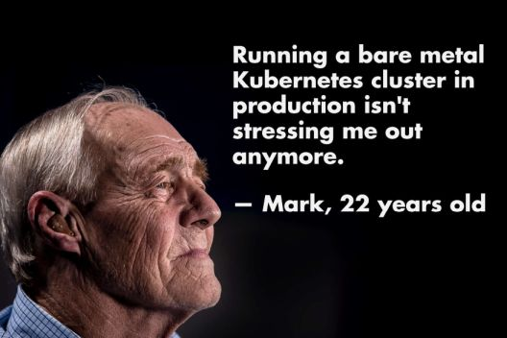

Slide 5

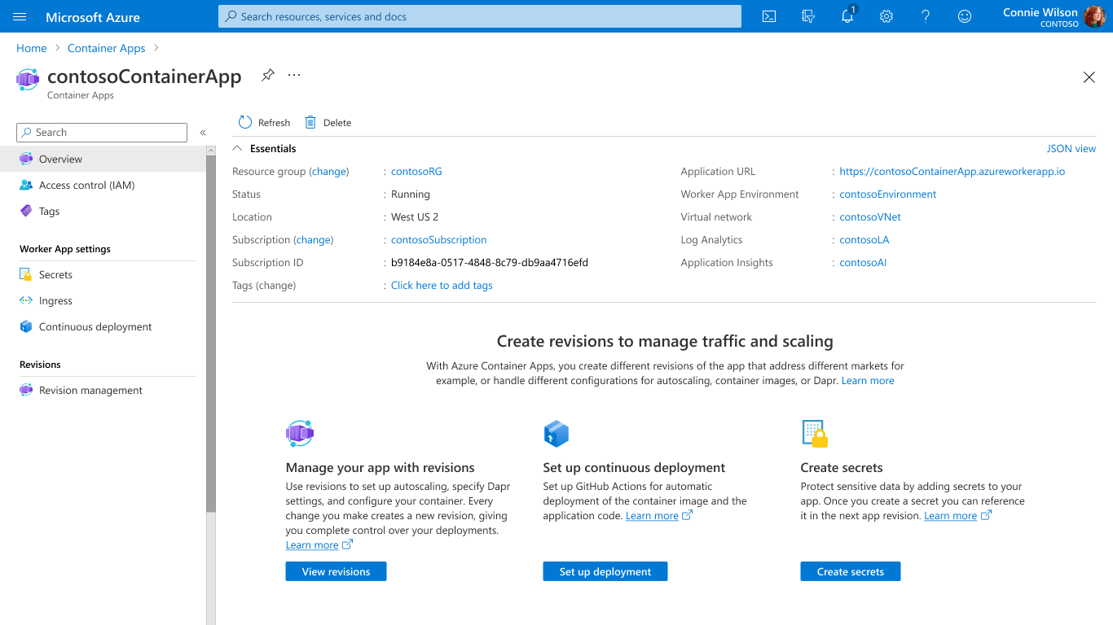
Scale with flexible serverless containers
Run containers, at scale
Accelerate developer productivity
Build modern apps on open-source
Run containers and scale in response to HTTP traffic or a growing list of KEDA-supported scale triggers including Azure Event Hub, Apache Kafka, RabbitMQ Queue, MongoDB, MySQL, and PostgreSQL
Get robust autoscaling capabilities without the overhead of managing complex infrastructure.
Scale to zero and pay for only what you use, by the second.
Notes:
Container Apps is the only serverless container solution offering a combination of robust built-in HTTP-based auto-scaling (including scale to zero), and event-driven auto-scale to run containers that may be processing messages from queues, streams, or databases.
You can run containers and scale in response to HTTP traffic or a growing list of KEDA-supported scale triggers including Azure Event Hub, Apache Kafka, RabbitMQ Queue, MongoDB, MySQL, and PostgreSQL. Scale to zero and pay for only what you use, by the second.

Slide 6
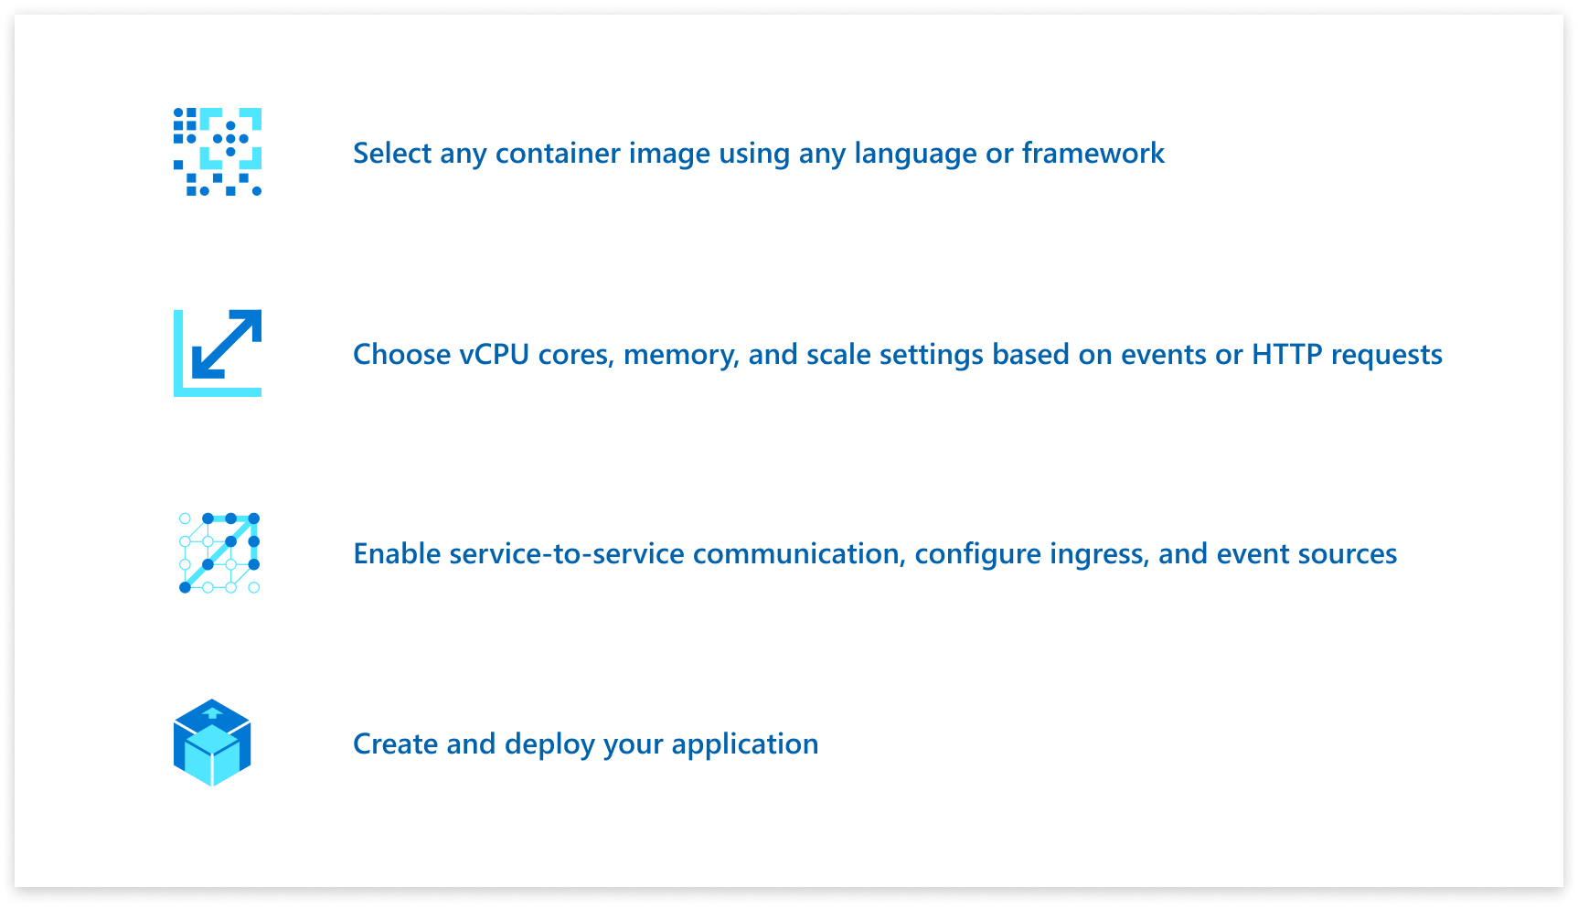
Accelerate developer productivity
Run containers, at scale
Accelerate developer productivity
Build modern apps on open-source
Build microservices, APIs, event processing workers, and background jobs using containers.
Write code in your favorite programming language and accelerate development with built-in Distributed Application Runtime (Dapr) integration to simplify common tasks like event processing, pub/sub, and service invocation.
Set up a code-to-cloud pipeline using GitHub Actions.
Notes:
Because you’re not burdened by managing a container orchestrator, this gives you more time to focus on building your applications. With Container Apps, you can build microservices, APIs, event processing workers, and background jobs using containers and any programming language or framework and easy code-to-cloud pipeline using GitHub Actions.
Through the built-in integration with Distributed Application Runtime (Dapr), you can simplify common tasks like event processing, pub/sub, service invocation, and more.

Slide 7
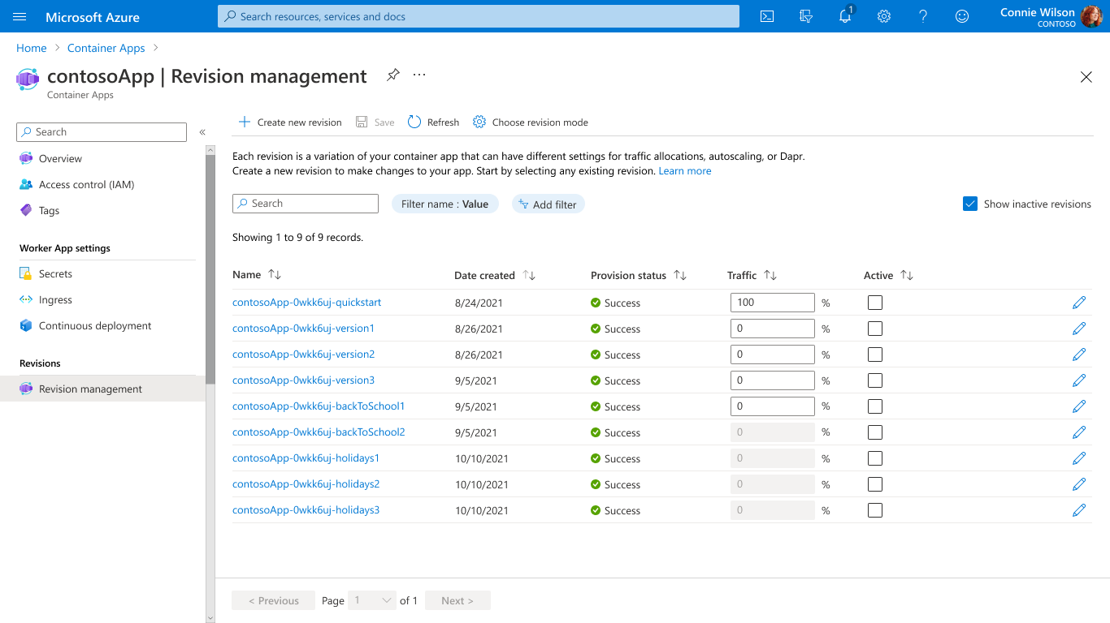
Build modern apps on open-source
Run containers, at scale
Accelerate developer productivity
Build modern apps on open-source
Create modern apps with open standards on a Kubernetes foundation and portability in mind.
Contribute directly to OSS projects to influence product capabilities.
Rely on streamlined application lifecycle tasks such as application upgrades and versioning, traffic shifting, service discovery, and monitoring.
Notes:
Container Apps is built on great open-source technology. It runs on top of Azure Kubernetes Service, KEDA, Dapr, and Envoy.
Perform modern application lifecycle tasks such as application upgrades, traffic shifting, and versioning with straightforward configurations. Rely on the built-in service discovery for microservice communication, fully managed HTTP and HTTP/2 ingress endpoints based on Envoy, and integrated load balancing, logging, and monitoring capabilities.

Slide 8
What can you build with Azure Container Apps?
Event-driven processing
Web Applications
Public API endpoints
Background processing
Microservices
MICROSERVICE A
MICROSERVICE B
HTTP TRAFFIC
MICROSERVICE C
80%
20%
REVISION 1
REVISION 2
Deploy and manage a microservices architecture with the option to integrate with Dapr.
E.g., queue reader application that processes messages as they arrive in a queue.
Deploy web apps with custom domains, TLS certificates, and integrated authentication.
HTTP requests are split between two revisions of the app — the first revision gets 80% of the traffic, while a new revision receives 20%.
E.g., continuously-running background process that transforms data in a database.
AUTO-SCALE CRITERIA
AUTO-SCALE CRITERIA
AUTO-SCALE CRITERIA
AUTO-SCALE CRITERIA
AUTO-SCALE CRITERIA
Individual microservices can
scale independently using any KEDA scale triggers
Scaling is determined by the number of messages in the queue
Scaling is determined by the number of concurrent HTTP requests
Scaling is determined by the number of concurrent HTTP requests
Scaling is determined by the level of CPU or memory load
Notes:
You may be wondering what sort of applications can you build with Azure Container Apps?
Here are some common ones including:
Running microservices
Web Applications
Deploying API endpoints
Hosting background processing applications
Handling event-driven processing
With each of those applications, you can dynamically scale based on:
HTTP traffic
Event-driven processing
CPU or memory load
Any KEDA-supported scaler

Slide 9
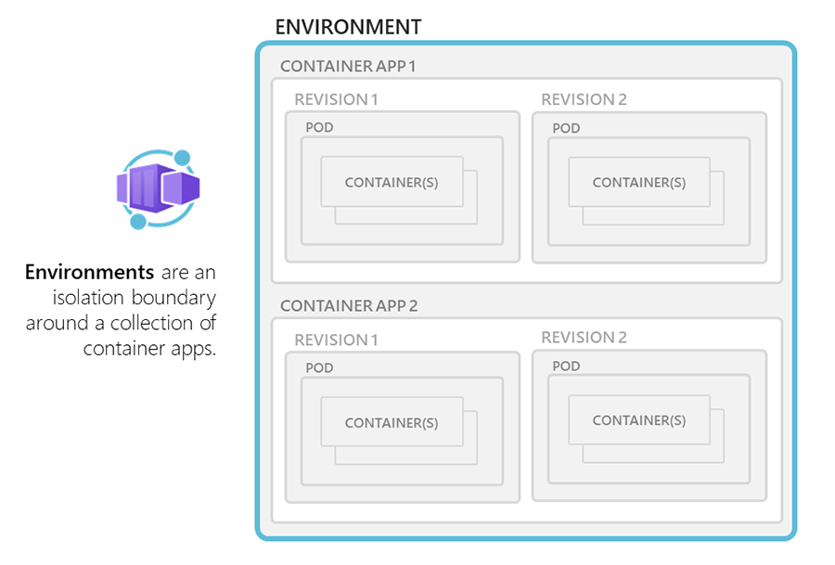
Environments
Notes:
Individual container apps are deployed to a single Container Apps environment, which acts as a secure boundary around groups of container apps. Container Apps in the same environment are deployed in the same virtual network and write logs to the same Log Analytics workspace.
Reasons to deploy container apps to the same environment include situations when you need to:
Manage related services
Deploy different applications to the same virtual network
Have applications communicate with each other using Dapr
Have applications to share the same Dapr configuration
Have applications share the same log analytics workspace

Slide 10
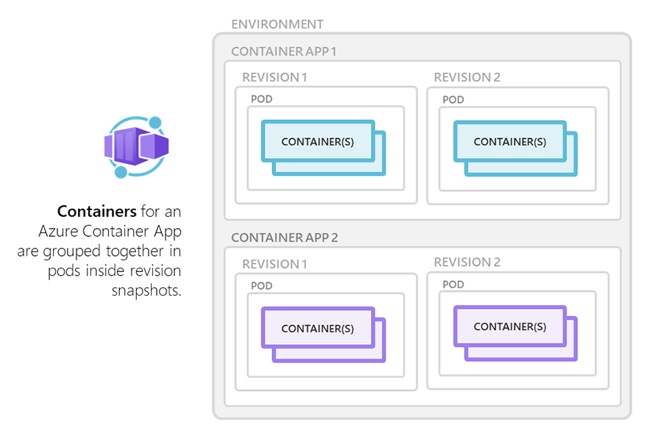
Containers
Notes:
Azure Container Apps manages the details of Kubernetes and container orchestrations for you. Containers in Azure Container Apps can use any runtime, programming language, or development stack of your choice.
Azure Container Apps supports:
Any Linux-based container image
Containers from any public or private container registry
However, Azure Container Apps can't run privileged containers or processes that requires root access.
Additional features include:
There is no required base container image.
Changes to the template ARM configuration section triggers a new container app revision.
If a container crashes, it automatically restarts.
You can define multiple containers in a single container app. Groups of containers are known as pods. The containers in a pod share hard disk and network resources and experience the same application lifecycle.
Reasons to run containers together in a pod include:
Use a container as a sidecar to your primary app.
Use of a shared disk space and virtual network.
Share scale rules among containers.
Group together multiple containers that need to always run together.
Enable direct communication among containers on the same host.

Slide 11
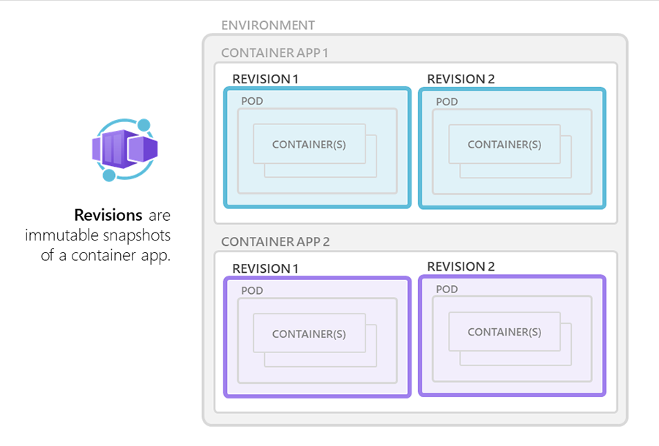
Revisions
Notes:
A revision is an immutable snapshot of a container app.
The first revision is automatically created when you deploy your container app.
New revisions are automatically created when a container app's template configuration changes.
While revisions are immutable, they're affected by changes to global configuration values, which apply to all revisions.
Revisions are most useful when you enable ingress to make your container app accessible via HTTP. Revisions are often used when you want to direct traffic from one snapshot of your container app to the next. Typical traffic direction strategies include A/B testing and BlueGreen deployment.

Slide 12
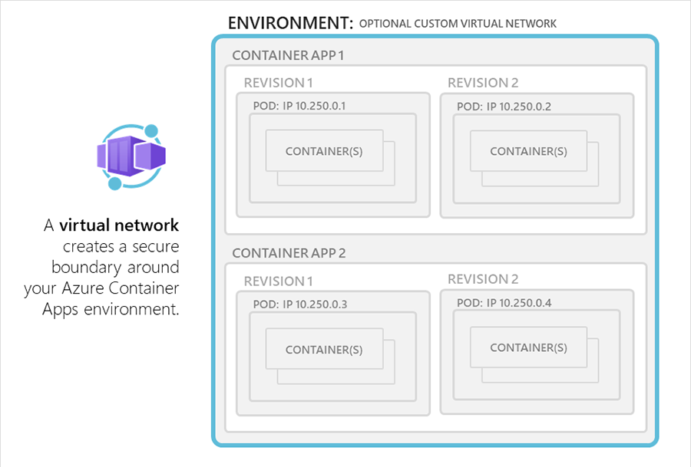
Virtual Network
Notes:
We start by creating a virtual network and 3 subnets: Control Plane, Apps, and VMs
The control plane subnet will be the source of IPs for the control plane components for ACA as well as the container apps.
(The apps subnet is not currently being used, but is currently reserved for extensibility in the future for when we integrate with Atlas or another backend)
We are currently determining potential solutions for allowing customers to provide a smaller ip range if they don’t need scale that would dictate a /21 as we currently require two /21s at this time
The VM subnet will host a virtual machine that will be used in the demonstration
Once we have set up our network, we will create a container apps environment and pass in the the internal-only flag, which will create an environment without an inbound public ip address
When you use the internal only flag, we do not automatically register the domain for the internal load balancer created for the environment, therefore it will not auto resolve for you
You can retrieve the default domain for the environment and the static private Ip address and create a private dns zone for the domain linked to your azure vnet
Once you have done this you will add add a wildcard record that will resolve any traffic bound for your default domain to the static ip address assigned to the environment
We will test this out by creating a VM in the VM subnet and ensuring proper inbound rules are configured to allow ssh
We deploy an api endpoint as a container app to the internal environment that is exposed to callers both in the environment and from within the Vnet.
We curl the api endpoint for the application and see a response because the vm and container app are appropriately configured to communicate
We can then go back to the Containerapp and update it to internal only, meaning only other container apps in the same environment can hit the api endpoint
When we run the curl command from the VM a second time, we see that the container app does not respond to the curl request, due to the visibility change
OTHER CALLOUTS: We are working on documentation for firewall requirements. Keep in mind your service should be able to make use of private endpoints to acess other services and unlike AKS private cluster, this approach can provide network isolation without the outbound type UDR/Private endpoint on the service itself needed

Slide 13

Ingress
Environment (virtual network boundary)
Container app 1
Revision 1
Revision 2
Pod
Pod
Pod
Pod
Internal or external visibility with TLS termination and support for HTTP/1.1 and HTTP/2
Container(s)
Container(s)
Container(s)
Container(s)
80%
20%
Ingress
Notes:
Azure Container Apps allows you to expose your container app to the public web by enabling ingress. When you enable ingress, you do not need to create an Azure Load Balancer, public IP address, or any other Azure resources to enable incoming HTTPS requests.
With ingress enabled, your container app features the following characteristics:
Supports TLS termination
Supports HTTP/1.1 and HTTP/2
Endpoints always use TLS 1.2, terminated at the ingress point
Endpoints always expose ports 80 (for HTTP) and 443 (for HTTPS).
By default, HTTP requests to port 80 are automatically redirected to HTTPS on 443.
Your ingress IP and fully qualified domain name can either be visible externally to the internet, or internally within a VNET. With ingress enabled, your application is assigned a fully qualified domain name (FQDN).
Your Container Apps environment has a single public IP address for applications with external ingress visibility, and a single internal IP address for applications with internal ingress visibility. Therefore, all applications within a Container Apps environment with external ingress visibility share a single public IP address. Similarly, all applications within a Container Apps environment with internal ingress visibility share a single internal IP address. HTTP traffic is routed to individual applications based on the FQDN in the host header.

Slide 14
Secrets management
"template": {
"containers": [
{
"image": "myregistry/myQueueApp:v1",
"name": "myQueueApp",
"env": [
{
"name": "QueueName",
"value": "myqueue"
},
{
"name": "ConnectionString",
"secretref": "queue-connection-string"
}
]
}
],
}
Securely store sensitive configuration elements that are then available to containers through environment variables, scale rules, and Dapr
Notes:
Azure Container Apps allows your application to securely store sensitive configuration values. Once defined at the application level, secured values are available to containers, inside scale rules, and via Dapr.
Secrets are scoped to an application, outside of any specific revision of an application.
Adding, removing, or changing secrets does not generate new revisions.
Each application revision can reference one or more secrets.
Multiple revisions can reference the same secret(s).
When a secret is updated or deleted, you can respond to changes in one of two ways:
Deploy a new revision.
Restart an existing revision.

Slide 15
Managed Identity
A system-assigned identity is tied to your container app and is deleted when your container app is deleted. An app can only have one system-assigned identity.
A user-assigned identity is a standalone Azure resource that can be assigned to your container app and other resources. A container app can have multiple user-assigned identities. The identity exists until you delete them.
Limitations:
Pull an image from Azure Container Registry
Define scaling rules or Dapr configuration
To access resources that require a connection string or key, such as storage resources, you'll still need to include the connection string or key in the secretRef of the scaling rule.

Slide 16
Observability
Log Analytics – stderr/stdout, small delay​
Metrics – CPU, Memory, Bytes in/out, Requests​
Alerts – based on metrics, log search, admin signals (e.g., create, update, delete container app)​
Streaming Logs – stderr/stdout, real-time​:
az containerapp logs show -n MyContainerapp -g MyResourceGroup
Connect to Console – connect to run shell commands
az containerapp exec -n MyContainerapp -g MyResourceGroup --command bash

Slide 17

Logging
Environment
Container app 1
Revision 1
Revision 2
Pod
Pod
Containers write logs to standard output or standard error streams surfaced via Log Analytics
Container(s)
Container(s)
stderr/stdout
stderr/stdout
Log Analytics
Notes:
Azure Container Apps gathers a broad set of data about your container app and stores it using Log Analytics. You can then use the Azure CLI or the Azure Portal to run queries against your Log Analytics workspace and visualize the results.

Slide 18
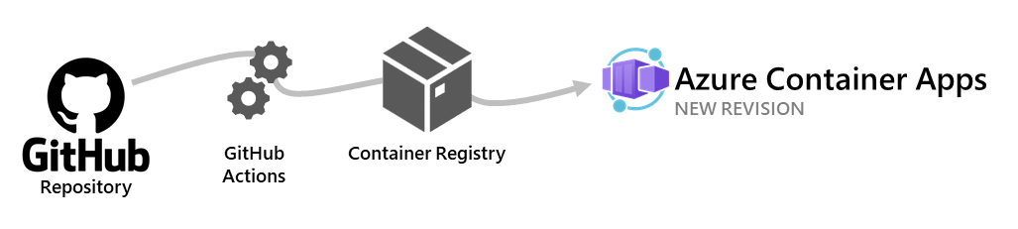
Notes:
Use GitHub Actions to publish revisions to your container app. As commits are pushed to your GitHub repository, a GitHub Action is triggered which updates the container image in the container registry. Once the container is updated in the registry, Azure Container Apps creates a new revision based on the updated container image.
The github-action add command creates a GitHub Actions integration with your container app. You can also configure continuous deployment through the Azure Portal.

Slide 19


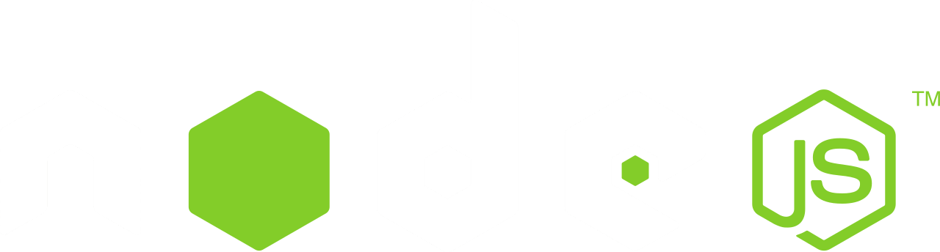



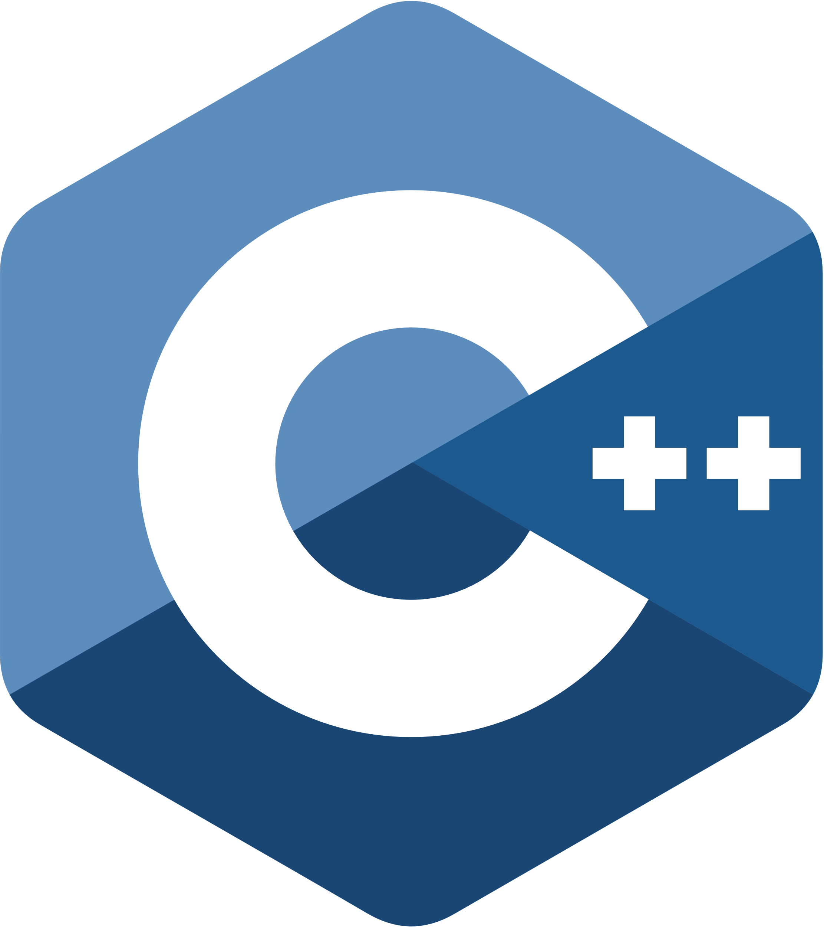
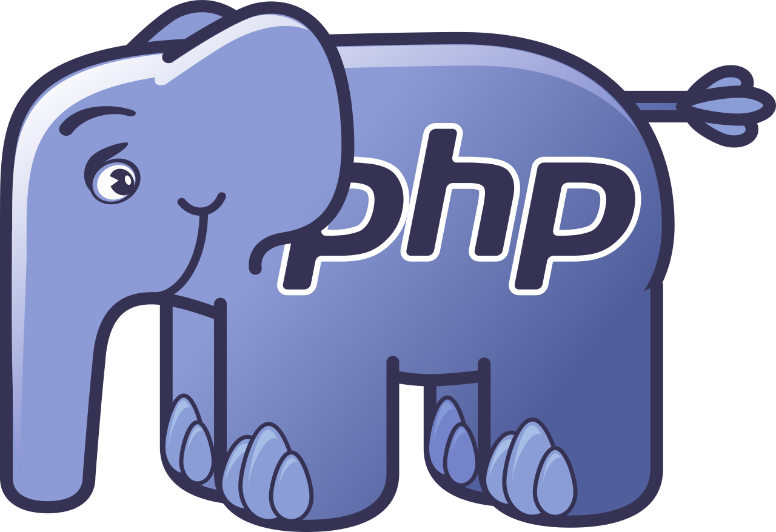








Microservices using any language or framework Any cloud or edge infrastructure
Application code
Microsoft services written in any code or framework
Distributed Application Runtime
HTTP API
gRPCz API
Service-to-service invocation
State management
Publish and subscribe
Resource bindings and triggers
Actors
Observability
Secrets
Extensible
Portable, event-driven, runtime for building distributed applications across cloud and edge
Hosting infrastructure
dapr.io
Azure Arc
On-premises
Notes:
Building microservices and distributed application is hard.
Dapr helps developers build event-driven, resilient distributed applications. Whether on-premises, in the cloud, or on an edge device, Dapr helps you tackle the challenges that come with building microservices and keeps your code platform agnostic.
Dapr is a set of APIs that makes it easy for you to write distributed applications. It runs as a sidecar process next to an application, whether on Kubernetes or any other environment, and gives you a set of primitives in the form of pub/sub, state management, secrets management, event triggers, and service-to-service calls that are secured and reliable. With Dapr, developers focus on building business logic instead of infrastructure.
The project was created in 2019 at Microsoft. Over time, many community members have joined and contributed to the project, extending it and helping it reach a stable 1.0 release in February 2021. Today, the Dapr Steering and Technical Committee governs the project with representatives from Alibaba, Intel, and Microsoft. And in November 2021, Dapr joined the Cloud Native Computing Foundation as an incubating project.

Slide 20
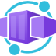
Fully managed Dapr using the sidecar model
Containerized application
sidecar
Dapr API
HTTP of gRPC
Service-to-service invocation POST http://localhost:3500/v1.0/invoke/cart/method/neworder
State management GET http://localhost:3500/v1.0/state/inventory/item67
Publish and subscribe POST http://localhost:3500/v1.0/publish/shipping/orders
Notes:
Azure Container Apps offers a fully managed version of the Dapr APIs. With Dapr for Azure Container Apps, sidecars can be enabled to run next to your application instances and provide a rich set of capabilities and productivity gains
Container Apps does not currently support the native Dapr components schema. The above example uses the supported schema.
With Azure Container Apps, you get a fully managed version of the Dapr APIs when building microservices. When you use Dapr in Azure Container Apps, you can enable sidecars to run next to your microservices that provide a rich set of capabilities. Available Dapr APIs include Service to Service calls, Pub/Sub, Event Bindings, State Stores, and Actors.

Slide 21




Application autoscaling made simple Open-source, extensible, and vendor agnostic
Metrics Adapter | Controller | Scaler
Intelligently scale your event-driven applications
Out-of-the-box scalers for various vendors, databases, messaging systems, telemetry systems, CI/CD, and more
Event-driven
Built-in scalers
Kubernetes-based Event Driven Autoscaler
Support for triggers across variety of cloud providers & products
Bring rich scaling to every workload
Vendor-agnostic
Rich capabilities
Drive the scaling of any container based on a growing list of 35+ event sources, known as: scalers
keda.sh

Slide 22

Scaling
KEDA
HTTP
Event-driven
CPU
Memory
{
"name": "http-rule",
"http": {
"metadata": {
"concurrentRequests": 50
}
}
}
artemis-queue, kafka, aws-cloudwatch, aws-kinesis-stream, aws-sqs-queue, azure-blob, azure-eventhub, azure-servicebus, azure-queue, cron, external, gcp-pubsub, huawei-cloudeye, ibmmq, influxdb, mongodb, mssql, mysql, postgresql, rabbitmq, redis, redis-streams, selenium-grid, solace-event-queue, ..
{
"name": "cpu-rule",
"custom": {
"type": "cpu",
"metadata": {
"type": "Utilization",
"value": "50"
}
}
}
{
"name": "mem-rule",
"custom": {
"type": "memory",
"metadata": {
"type": "AverageValue",
"value": "512"
}
}
}
Support for scale to zero and specifying minimum/maximum replicas
Support for specifying minimum/maximum replicas
Notes:
When it comes to scaling, you have a number of choices here, some of which support scaling to zero.
Both HTTP scaling and Event-driven scaling support scaling to zero when there are no requests, or when there are no events to process.
HTTP scaling
With an HTTP scaling rule, you have control over the threshold that determines when to scale out. You define the maximum number of concurrent requests. Once the number of requests exceeds this value, then more replicas are added, up to the maxReplicas amount.
Event-driven scaling
Container Apps can scale based of a wide variety of event types. Any event supported by KEDA, is supported in Container Apps. Examples include: …
CPU scaling
CPU scaling allows your app to scale in or out depending on how much the CPU is being used utilizing the KEDA CPU scale trigger.
Memory scaling
Memory scaling allows your app to scale in or out depending on how much memory is being used utilizing the KEDA Memory scaler
You also have a choice to set a minimum number of instances that will always be up and running. Those will then be charged at a reduced “Idle” rate as long as those applications are not processing requests.

Slide 23
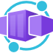
Demo
Public preview
Notes:
Limitations
Environments per region 2
Container apps per environment 20
Replicas per container app 25
Cores per replica 2
Cores per environment 50

Slide 24
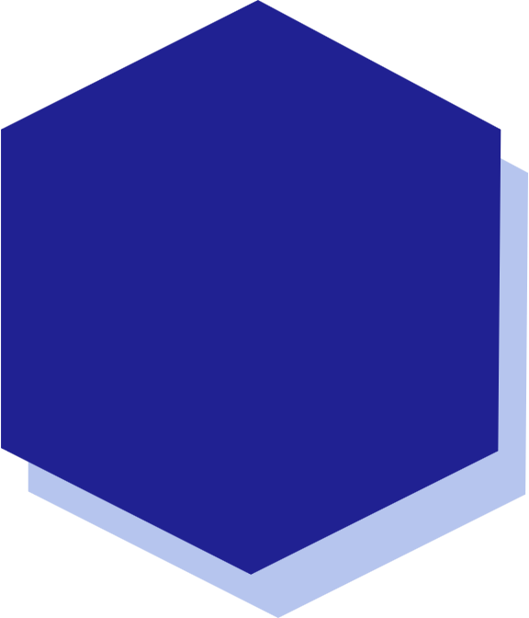
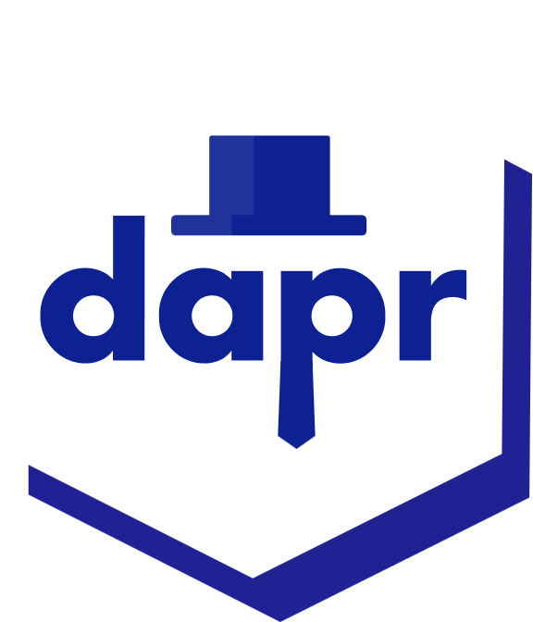
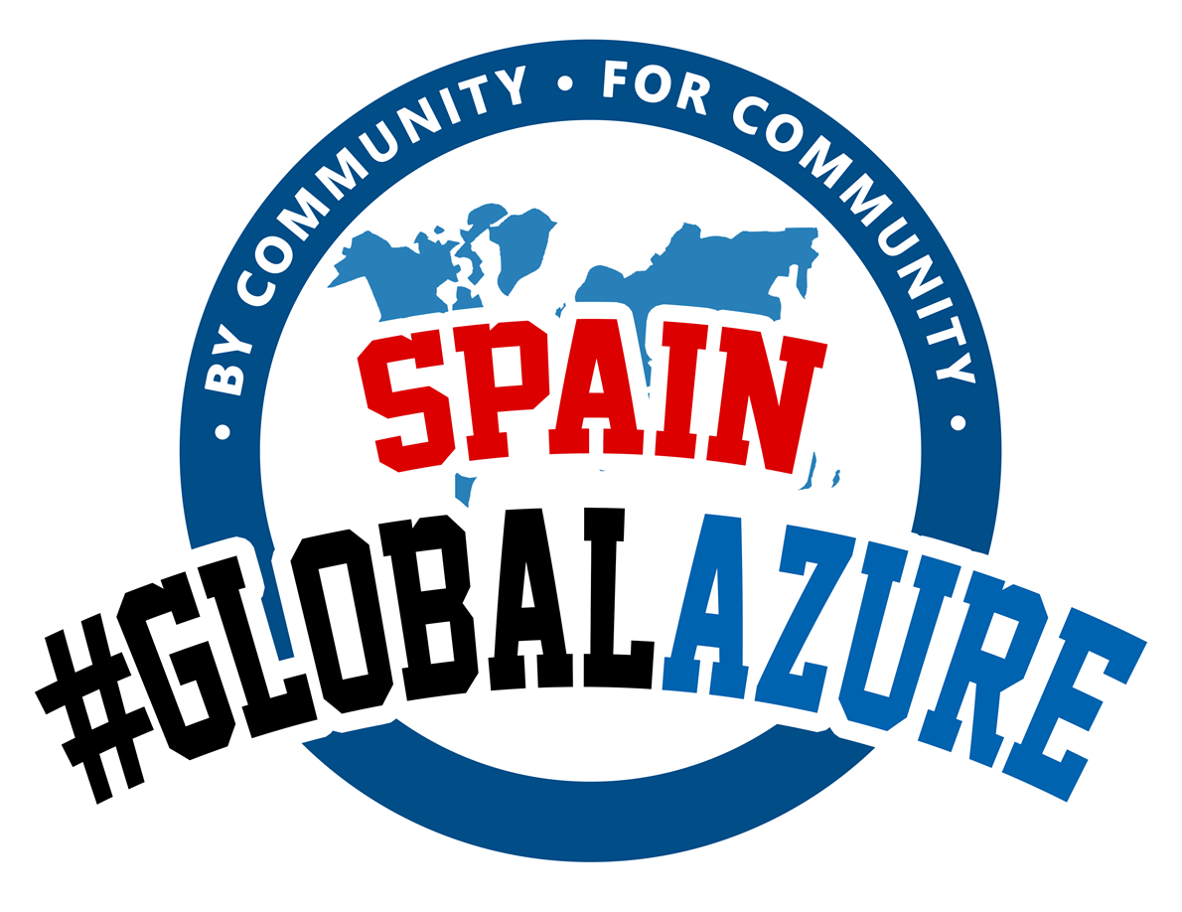
Azure Containers Apps Demo
Check
Point
Runner
Service
PubSub Topic
Race
Simualtor
Race
Control
State Store
#GlobalAzure
Notes:
The actor pattern describes actors as the lowest-level “unit of computation”. In other words, you write your code in a self-contained unit (called an actor) that receives messages and processes them one at a time, without any kind of concurrency or threading.

Slide 25
Get started with Azure Container Apps today
https://aka.ms/containerapps
#GlobalAzure
Notes:
Azure Container Apps billing consists of two types of charges:
Resource consumption: The amount of resources allocated to your container app on a per-second basis, billed in vCPU-seconds and GiB-seconds.
HTTP requests: The number of HTTP requests your container app receives.
The following resources are free during each calendar month, per subscription:
The first 180,000 vCPU-seconds
The first 360,000 GiB-seconds
The first 2 million HTTP requests
When a revision is scaled to zero replicas, no resource consumption charges are incurred.

